Slide 1
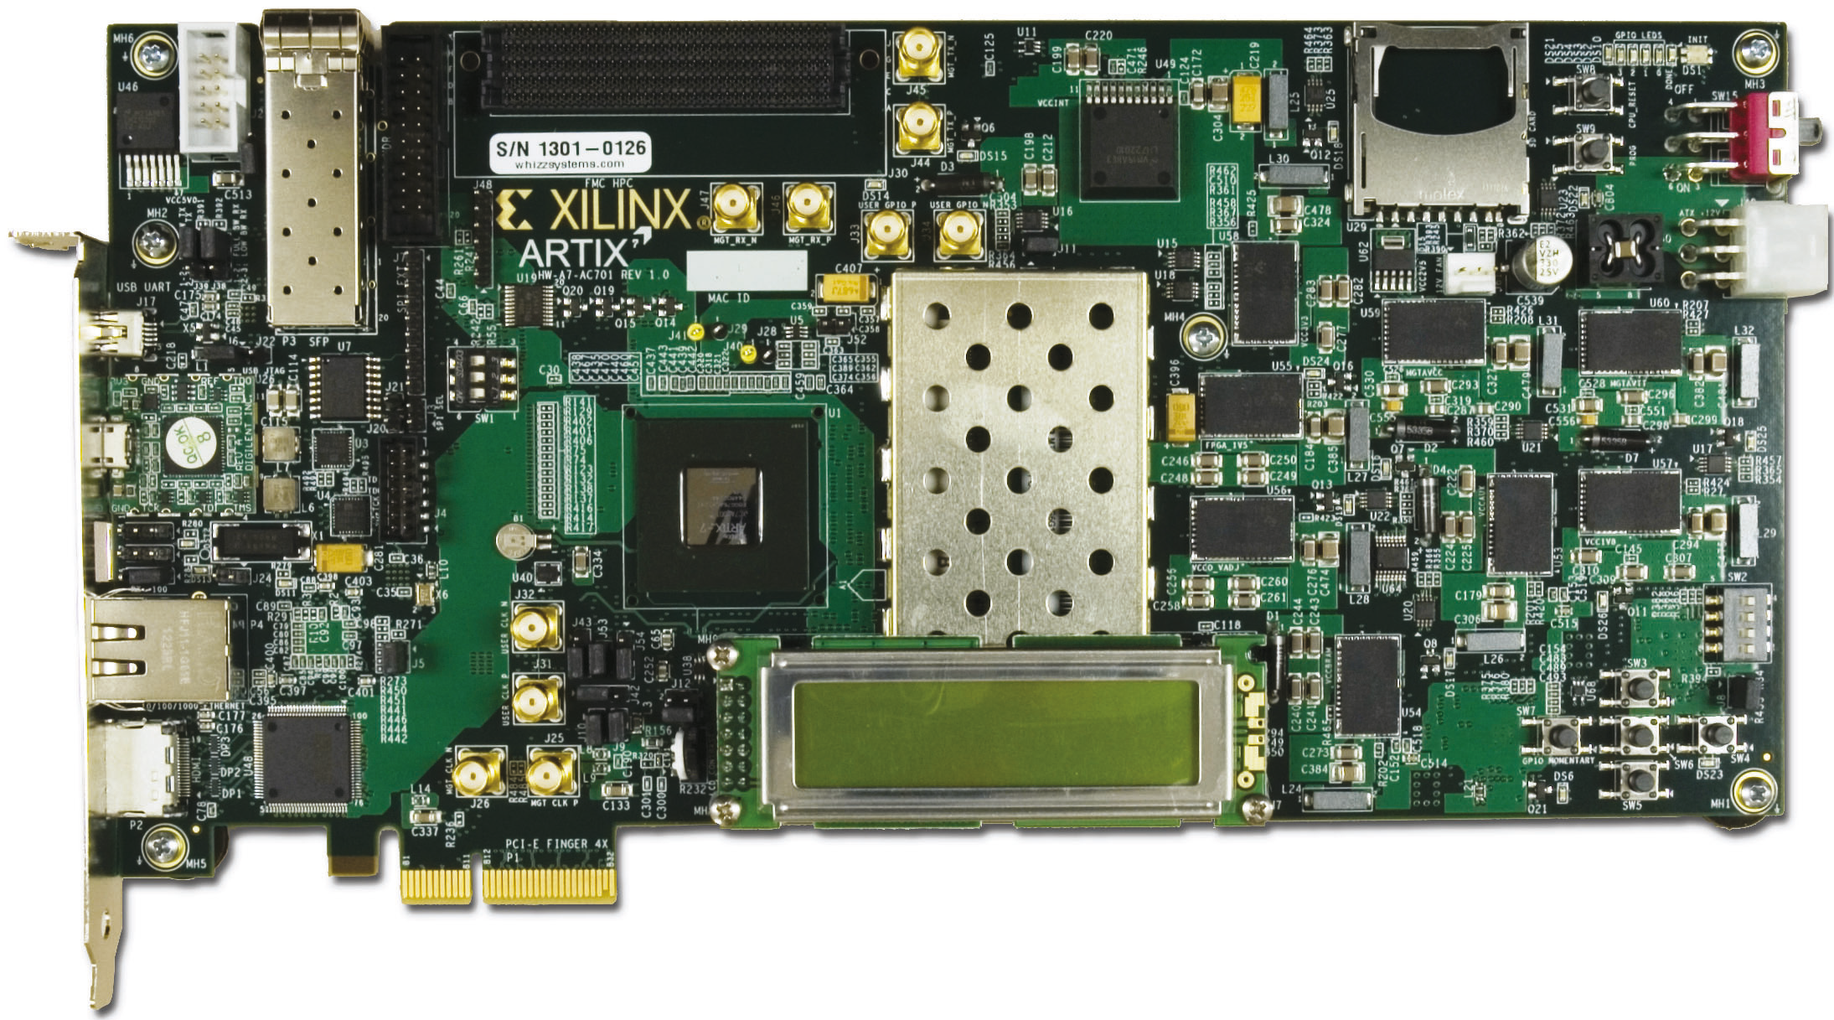
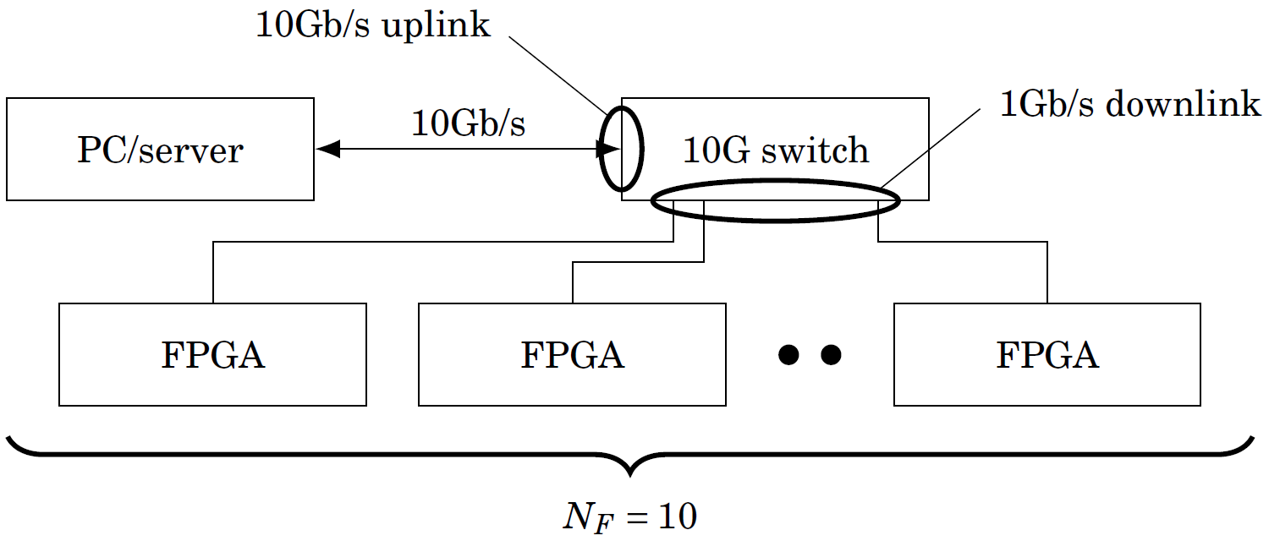
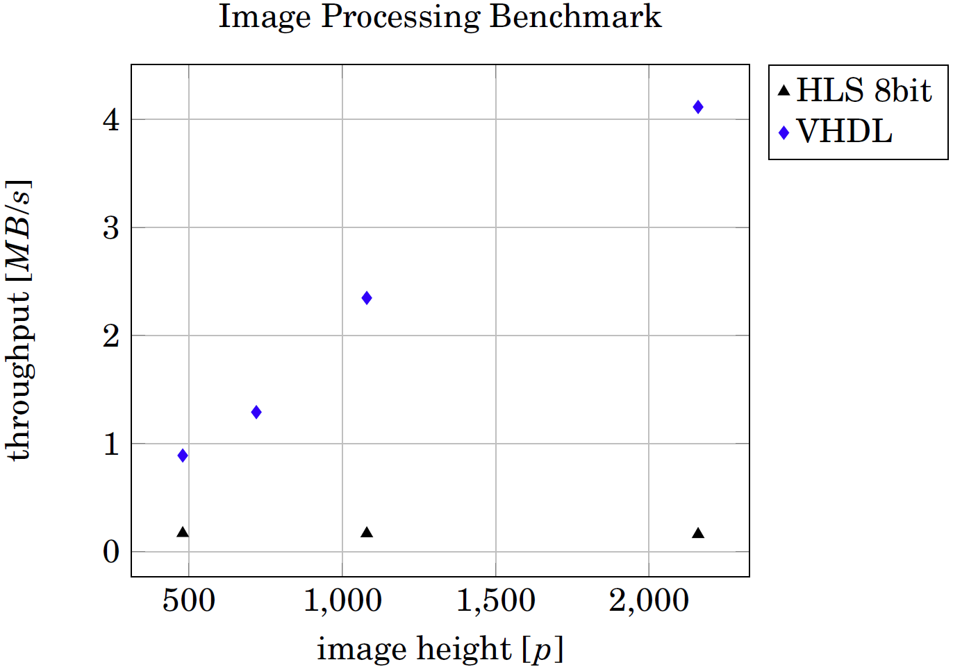
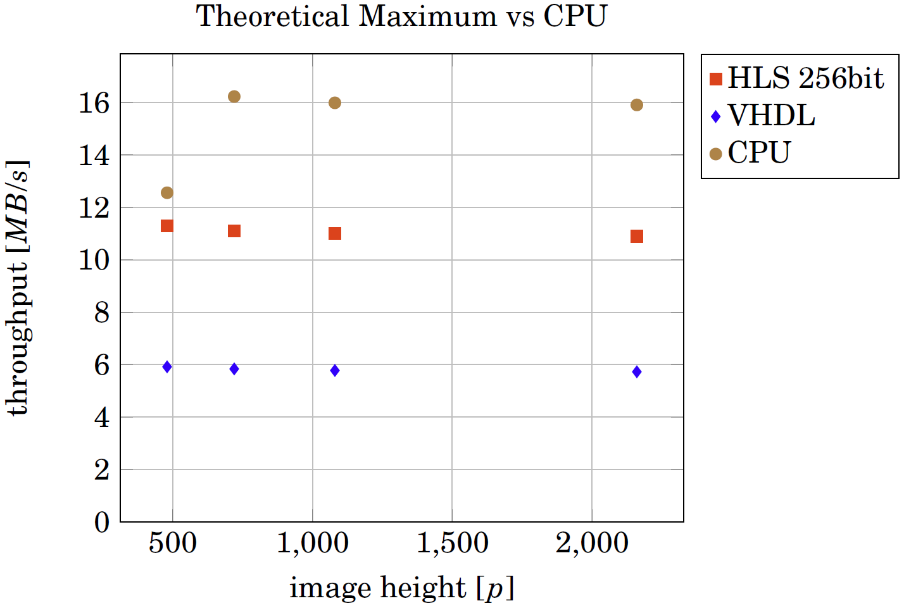
Exhibitor-Nr. E-11
Distributed FPGA for Enhanced Image Processing
Local contrast enhancement using a Wallis filter on multiple FPGAs with images of a resolution of 1500MP for use in virtual reality
Fig. 1-3: Original image processed with the Wallis filter on the FPGA produces the output image with a local contrast enhancement
Introduction
A dedicated hardware image processing algorithm using FPGA was implemented that is scalable onto multiple FPGAs. In a first run High Level Synthesis was used to describe a Wallis local contrast enhancement filter in C/C++ language that was then synthesized to hardware description language. To further improve throughput a VHDL solution was implemented.
Fig 5: Scalability of an FPGA network with 10 FPGAs
FPGA vs. CPU
A benchmark shows the performance differences between a CPU based and FPGA based solution (fig. 6). The throughput of both FPGA implementations (VHDL and HLS 256bit) can be improved by implementing the Wallis filter multiple times on one FPGA. By implementing the HLS solution twice or the VHDL solution three times, a regular CPU could already be outrunned by one FPGA.
Fig 4: Throughput of the FPGA implementations
Results
The result is a complete image processing pipeline that begins on a PC where the input image is sent via Ethernet to the FPGA where it is processed and sent pack to the PC. The achieved image throughput is 4.1MB/s primarily limited by the image processing core (fig. 4). The Wallis filter core alone is capable of processing up to 125Mp/s on the input. Concepts on scalability show how the processing power of FPGAs can be exploited if multiple image processing cores were implemented on one FPGA and also multiple FPGAs would work on a network (fig. 5).
Fig 6: Theoretical throughput of a CPU solution and two FPGA solutions
Students: Noah Hütter & Jan Stocker
Customer: Nomoko AG
Expert: Dr. Jürg M. Stettbacher
Examiner: Michael Pichler
michael.pichler@fhnw.ch
FPGA programmed using C/C++
1500MP processing within 3s
Throughput: 500Mp/s (4 FPGAs)

